Slide 1
Quantization and SNR
MATLAB ONRAMP - SECTION THREE
Sampling, quantizing and measuring signal quality in MATLAB
Under the supervision of DR. Lobna Abouelmagd
Prepared by ENG. Moamen Yasser
Notes:
Section Three covers two textbook examples (2.13 and 2.14) on analog-to-digital conversion: sample a sine wave, quantize it with 4 bits, plot the result and measure the quantization SNR.

Slide 2
Quantization and SNR
MATLAB ONRAMP - SECTION THREE
Part 1: Example 2.13
Quantize a sine wave · Part 1 of 2

Slide 3
Example 2.13: quantize a sine wave
THE PROBLEM
A sinusoid x(t) = 4.5·sin(2π·100t) is sampled at 8,000 Hz.
a) Quantize it with 4 bits for a range of −5 V to 5 V and plot it.
b) Calculate the SNR due to quantization.
100 Hz
8,000 Hz
signal frequency
sampling rate
4 bits
±5 V
16 steps
signal range
goal: turn a smooth sine into a staircase of levels, then measure how good it is
Notes:
Problem: a computer can only store numbers with a limited number of bits. Quantization rounds every sample to the nearest of a few allowed levels. We need to see the effect (plot) and measure the damage (SNR).

Slide 4
Set the sampling parameters
TASK 1
Name the signal frequency signalFrequency, the sampling rate samplingRate and the sampling period samplingPeriod = 1/samplingRate. The time vector timeVector steps by samplingPeriod from 0 to 0.02 s, giving 161 samples.
signalFrequency=100;
samplingRate=8000;
samplingPeriod=1/samplingRate;
timeVector=0:samplingPeriod:.02;
create signalFrequency, samplingRate, samplingPeriod and a time vector timeVector from 0 to 0.02 s
Notes:
Purpose: define every number once so the rest of the program can reuse it. Problem fixed: without a time vector there is nothing to evaluate the sine on. Ts = 125 microseconds; 0.02 s is exactly two periods of 100 Hz.

Slide 5
Generate the original signal
TASK 2
Apply the sine formula to every element of timeVector at once. originalSignal is a vector of 161 samples with a peak of 4.5 V.
%original signal
originalSignal= 4.5*sin(2*pi*100*timeVector);
build originalSignal with originalSignal = 4.5*sin(2*pi*100*timeVector) and check that max(originalSignal) is close to 4.5
Notes:
Purpose: create the analog-like input. MATLAB is vectorized, so one line computes all 161 samples.

Slide 6
Define the quantization rule
TASK 3
A 4-bit quantizer has numLevels = 2^4 = 16 steps across the range. The step size is stepSize = (maxVoltage - minVoltage)/numLevels = 10/16 = 0.625 V.
%quantization rule
maxVoltage=5;
minVoltage=-5;
numLevels=2^4;
stepSize=(maxVoltage-minVoltage)/numLevels;
set maxVoltage, minVoltage and numLevels, then compute stepSize and check that it equals 0.625
Notes:
Purpose: describe the quantizer. Bits decide l, the range decides delta. Smaller delta means a smaller error, so more bits means better quality.

Slide 7
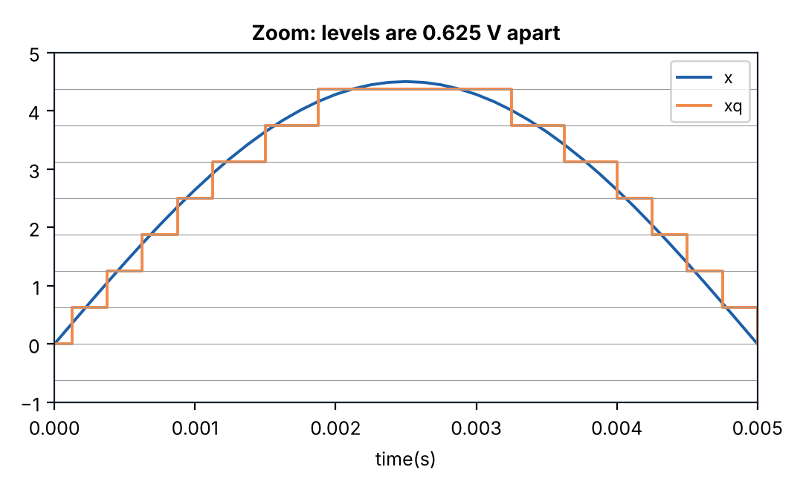
Quantize the signal
TASK 4
Shift originalSignal so the range starts at 0, divide by stepSize and round to a whole step levelIndex. Convert back to volts with quantizedSignal.
levelIndex=round((originalSignal-minVoltage)/stepSize);
quantizedSignal=minVoltage+levelIndex*stepSize;
compute levelIndex and quantizedSignal, then check that every quantizedSignal value sits on a multiple of 0.625 above -5
Notes:
This is the heart of the program. (x-xmin)/delta counts how many steps the sample is above the bottom of the range; round picks the nearest step number; xmin+i*delta turns that number back into volts.

Slide 8
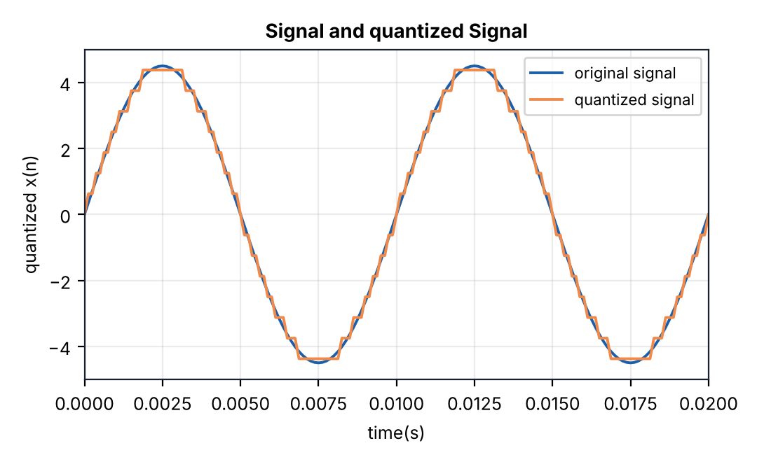
Plot original and quantized
TASK 5
Plot both signals on the same axes, then add a legend, a title and axis labels so the figure can be read.
plot(timeVector,originalSignal,timeVector,quantizedSignal);
legend('original signal','quantized signal');
title('Signal and quantized Signal');
xlabel('time(s)');
ylabel('quantized x(n)');
plot originalSignal and quantizedSignal together and add the legend, title and labels from the code
Notes:
Purpose: see the quantization. The orange curve follows the blue one in small steps, and it is clipped slightly at the peaks because 4.5 V sits between two levels.

Slide 9
Measure the quantization error
TASK 6
The error is the quantized value minus the original value. abs(quantizationError) gives its size, which can never exceed stepSize/2 = 0.3125 V.
quantizationError=quantizedSignal-originalSignal;
abs(quantizationError);
compute quantizationError and check that max(abs(quantizationError)) is below 0.3125
Notes:
Purpose: quantify how far each sample moved. Note: abs(eq); ends with a semicolon, so it prints nothing and eq itself stays signed. Remove the semicolon to see the sizes. Our run gives a maximum of about 0.297 V.

Slide 10
Example 2.13 part a: the full script
FULL EXAMPLE
signalFrequency=100;
samplingRate=8000;
samplingPeriod=1/samplingRate;
timeVector=0:samplingPeriod:.02;
%original signal
originalSignal= 4.5*sin(2*pi*100*timeVector);
%quantization rule
maxVoltage=5;
minVoltage=-5;
numLevels=2^4;
stepSize=(maxVoltage-minVoltage)/numLevels;
levelIndex=round((originalSignal-minVoltage)/stepSize);
quantizedSignal=minVoltage+levelIndex*stepSize;
plot(timeVector,originalSignal,timeVector,quantizedSignal);
legend('original signal','quantized signal');
title('Signal and quantized Signal');
xlabel('time(s)');
ylabel('quantized x(n)');
quantizationError=quantizedSignal-originalSignal;
abs(quantizationError);
Notes:
Parameters, signal, quantizer, plot, error: five blocks in one script.

Slide 11
Part b: signal and error powers
TASK 7
The mean of the squared samples is the average power. Find it for the signal (signalPower) and the error (errorPower). The .^ operator squares every element.
signalPower = mean(originalSignal.^2);
errorPower = mean(quantizationError.^2);
snrRatio = signalPower / errorPower;
compute signalPower, errorPower and snrRatio, and check that SNR is about 378
Notes:
SNR is signal power divided by noise power. Here the quantization error is the noise. E_x2 is about 10.1 (4.5 squared over 2); E_eq2 is about 0.0268.

Slide 12
Convert to dB and print
TASK 8
Engineers quote SNR in decibels: snrDb = 10·log10(snrRatio). In fprintf, %.2f prints a number with 2 decimals and \n starts a new line.
snrDb = 10 * log10(snrRatio);
fprintf('The SNR due to quantization is: %.2f dB\n', snrDb);
Command Window The SNR due to quantization is: 25.78 dB
run the script and check that the Command Window prints 25.78 dB
Notes:
Decibels compress the huge ratio 378 into a friendly number: 10*log10(378) = 25.78 dB. Rule of thumb: every extra bit adds about 6 dB.

Slide 13
Quantization and SNR
MATLAB ONRAMP - SECTION THREE
Part 2: Example 2.14
Quantize a signal stored in a file · Part 2 of 2

Slide 14
Example 2.14: a signal from a file
THE PROBLEM
A speech signal sampled at 8,000 Hz is stored in a file.
a) Quantize it with a 4-bit quantizer for −5 V to 5 V.
b) Plot the original, quantized and error signals.
c) Calculate the SNR.
8,000 Hz
4 bits
sampling rate
16 steps
±5 V
3 plots
signal range
signal, quantized, error
goal: save samples to a file, load them back, quantize and compare three plots
Notes:
Real systems read recorded samples from a file. Since we do not have the book's speech file, the program first creates signal.txt from the same 100 Hz sine.

Slide 15
Write the samples to a file
TASK 1
No data file? Create one. fopen opens signal.txt for writing ('w'), fprintf writes each sample on its own line and fclose closes the file.
signalFrequency=100;
samplingRate=8000;
samplingPeriod=1/samplingRate;
timeVector=0:samplingPeriod:.25;
originalSignal= 4.5*sin(2*pi*100*timeVector);
fileId=fopen('signal.txt','w');
fprintf(fileId,'%f\n',originalSignal);
fclose(fileId);
create signal.txt, then open it in the Current Folder and check that it holds 2001 lines
Notes:
Purpose: manufacture a test input. 0.25 s at 8000 Hz gives 2001 samples. %f writes 6 decimals, so the file stores slightly rounded values. fclose is essential: without it the file may not be fully written.

Slide 16
Load the file back
TASK 2
load reads the numbers in signal.txt into the vector speechSignal. The file holds only values, so rebuild the time axis from the number of samples and samplingRate.
samplingRate=8000;
speechSignal=load('signal.txt');
timeVector=(0:length(speechSignal)-1)/samplingRate;
load signal.txt into speechSignal and check that length(speechSignal) is 2001
Notes:
Purpose: read the data like a program would read a recording. t = (0:N-1)/fs means sample number divided by samples per second = time in seconds. The PDF repeats fm, Ts and x here; they are not needed once sig is loaded.

Slide 17
Quantize the loaded signal
TASK 3
The same rule as before, with speechSignal in place of originalSignal. Only the input name changes.
maxVoltage=5;
minVoltage=-5;
numLevels=2^4;
stepSize=(maxVoltage-minVoltage)/numLevels;
levelIndex=round((speechSignal-minVoltage)/stepSize);
quantizedSignal=minVoltage+levelIndex*stepSize;
quantize speechSignal and check that quantizedSignal has 2001 values
Notes:
Good practice: the quantizer works on any vector, so the same code handles a sine, speech or any other signal.

Slide 18
Plot with subplot and stairs
TASK 4
subplot(3,1,k) makes a grid of 3 rows and 1 column and selects row k. plot draws the original; stairs draws the quantized signal as steps.
subplot(3,1,1)
plot(timeVector,speechSignal);
xlabel('time(s)');
ylabel(' original Speech');
subplot(3,1,2)
stairs(timeVector,quantizedSignal);
xlabel('time(s)');
ylabel(' Quantized Speech');
plot the original in row 1 and the quantized signal in row 2
Notes:
stairs holds each value until the next sample, which is what a digital-to-analog converter does (sample and hold). Stacked axes share the same time scale so the signals are easy to compare.

Slide 19
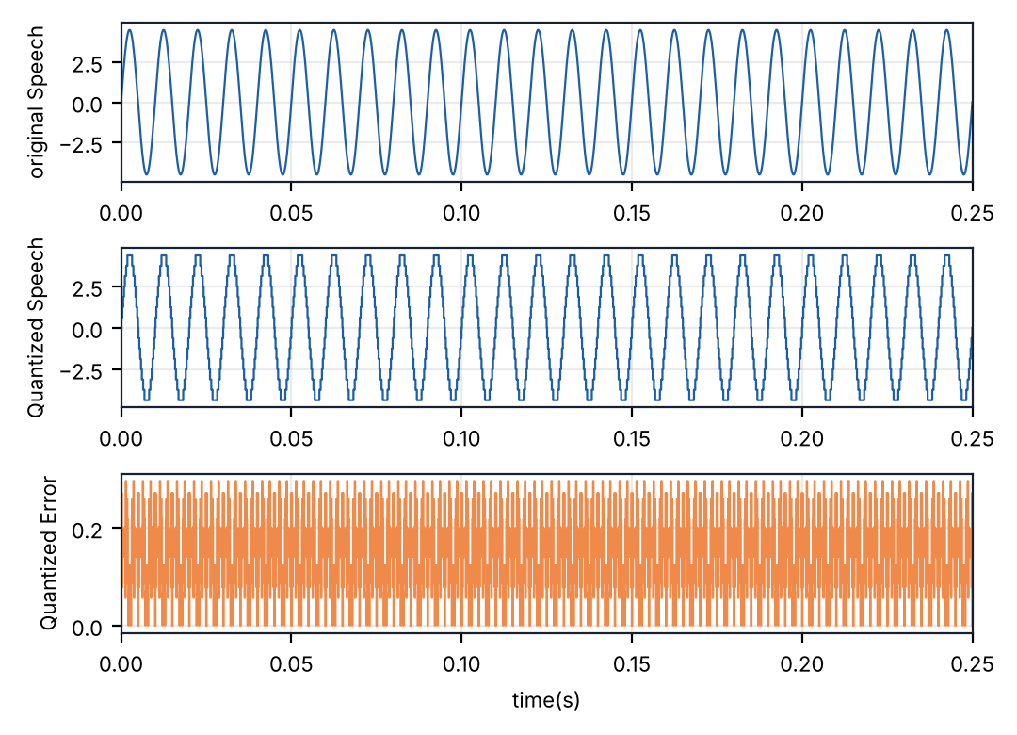
Plot the quantization error
TASK 5
Take the absolute error and draw it in the third row to finish the figure.
quantizationError=abs(speechSignal-quantizedSignal);
subplot(3,1,3)
stairs(timeVector,quantizationError);
xlabel('time(s)');
ylabel(' Quantized Error');
add the error plot in row 3 and check that it never goes above 0.3125
Notes:
The error stays between 0 and about 0.3 V, which is below delta/2 = 0.3125. That is the proof that the quantizer works as designed.

Slide 20
Example 2.14: the full script
FULL EXAMPLE
samplingRate=8000;
speechSignal=load('signal.txt');
timeVector=(0:length(speechSignal)-1)/samplingRate;
maxVoltage=5;
minVoltage=-5;
numLevels=2^4;
stepSize=(maxVoltage-minVoltage)/numLevels;
levelIndex=round((speechSignal-minVoltage)/stepSize);
quantizedSignal=minVoltage+levelIndex*stepSize;
subplot(3,1,1)
plot(timeVector,speechSignal);
xlabel('time(s)');
ylabel(' original Speech');
subplot(3,1,2)
stairs(timeVector,quantizedSignal);
xlabel('time(s)');
ylabel(' Quantized Speech');
quantizationError=abs(speechSignal-quantizedSignal);
subplot(3,1,3)
stairs(timeVector,quantizationError);
xlabel('time(s)');
ylabel(' Quantized Error');
Notes:
Left card: load and quantize (part a). Right card: three plots (part b). The SNR block (part c) is on the next slides.

Slide 21
Part c: SNR from the file data
TASK 6
The same power ratio as in Example 2.13, now computed from speechSignal and the absolute error quantizationError, then converted to decibels.
signalPower = mean(speechSignal.^2);
errorPower = mean(quantizationError.^2);
snrRatio = signalPower / errorPower;
snrDb = 10 * log10(snrRatio);
compute signalPower, errorPower, snrRatio and snrDb, and check that snrDb is about 25.78
Notes:
Using abs(eq) does not change the SNR, because squaring removes the sign.

Slide 22
Print the result
TASK 7
Use fprintf to report the SNR. The result matches Example 2.13 because both programs quantize the same 100 Hz sine with 4 bits.
fprintf('The SNR due to quantization is: %.2f dB\n', snrDb);
Command Window The SNR due to quantization is: 25.78 dB
run the whole script and check that the Command Window prints 25.78 dB
Notes:
Same signal, same quantizer, so the same SNR: reading the data from a file does not change the quality, it only changes where the data comes from.

Slide 23
More bits, less error
FURTHER PRACTICE
Change numLevels=2^4; to numLevels=2^8; and run again. Each extra bit adds about 6 dB of SNR.
set numLevels=2^8, rerun the script and check that the SNR is about 49.52 dB
Notes:
Each extra bit halves delta, which cuts the error power by 4 times, i.e. 6 dB. Measured values for this sine: 2 bits 12.55 dB, 4 bits 25.78 dB, 6 bits 37.01 dB, 8 bits 49.52 dB.

Slide 24
Quick reference: functions used
FURTHER PRACTICE
round(value)
rounds each value to the nearest integer
mean(values)
average of the elements of values
log10(values)
base-10 logarithm, used for decibels
fprintf
prints formatted text and numbers
fopen / fclose
open and close a file ('w' = write)
load('f.txt')
reads numbers from a text file
subplot(rows,cols,position)
selects plot position of a rows-by-cols grid
stairs(timeVector,values)
draws a staircase (sample-and-hold)
Notes:
A one-page summary of every new function in Section Three.

Slide 25
Thank You
MATLAB ONRAMP - SECTION THREE
Any questions?
Under the supervision of DR. Lobna Abouelmagd
Prepared by ENG. Moamen Yasser

